Slide 1
Split Liver Variance
Liver and Intestinal Transplantation Committee

Slide 2
What problem will the proposal solve?
Insufficient livers available for all of the candidates who would benefit from liver transplant
Logistical complications associated with using split livers at two separate programs can impede split liver transplantation
Existing split liver variance is not often used
Notes:
The existing split liver variance has only been used 4 times.

Slide 3
What is the proposed solution?
A new variance
Participating transplant hospitals could transplant both segments of a split liver into candidates at their own program or affiliated programs
3-year time limit
Can use either segment for the first candidate
Must offer second segment to Status 1 and MELD/PELD >32 within 500nm first
Notes:
This is different from the existing split liver variance in that either segment can be used for the first candidate. Under the existing variance, participating hospitals can only use the second segment at their own center if the first candidate uses the right tri-segment or right lobe.

Slide 4
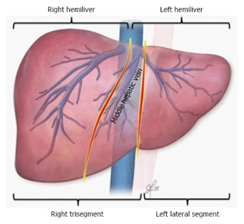
Existing Variance | Proposed Variance
Must use right hemiliver or trisegment first | Can use either side first
Do not need to offer the remaining segment first | Must first offer the remaining segment to Status 1 and MELD>32 within 500nm first
Can participate by DSA or region | Individual centers can participate
Notes:
The proposed variance differs from the existing split liver variance.
The existing variance has only been used 4 times. In order to provide more incentive to split livers, the committee proposes this expanded variance. (Removing the existing existing variance is not part of this proposal.)
However, in order to make sure that there is still sufficient access for all candidates, there is a provision to offer the second segment to the most urgent candidates.

Slide 5
How will members implement this proposal?
Interested programs can apply to the OPTN to join the open variance
Notes:
OPTN will provide an application.
They submit the application, and it gets approved by the OPTN.
If they join as a region, DSA, or other group, and not all members of the group agree, the application has to be considered by the liver committee.

Slide 6
How will the OPTN implement this proposal?
Review and approve applications
Monitor and evaluate changes in how often livers are split and how those are used
Ensure variance expires in 3 years
Notes:
Monitoring and evaluating the changes is so that the committee can see if there is merit to making this change part of normal allocation at the end of the 3 years.
Extra info about what will be monitored:
The following questions, and any others subsequently requested by the Committee, will guide the evaluation of the proposal after implementation:
Has the number of split liver transplants increased?
Have the characteristics of split liver recipients changed?
Has there been a change in liver discards?
If livers are split, did the remaining segment stay at the same or affiliated center?
Has the number of programs performing split liver transplants increased?
The following metrics, and any others subsequently requested by the Committee, will be evaluated as data become available to compare performance before and after the implementation of this variance:
The number (and percent) of liver transplants (whole vs. split) overall, and by both recipient and donor demographics, including but not limited to:
Recipient age,
allocation MELD/PELD at transplant,
index recipient liver segment (left lobe or left-lateral segment vs. right lobe or right tri-segment)
Descriptive statistics on index and secondary recipient of split liver, including but not limited to:
Allocation MELD/PELD at transplant,
gender,
OPTN region
The number (and percent) of livers recovered that are utilized vs. discarded, overall and by demographics, including but not limited to:
Organ type (whole vs. split),
OPTN region
Geography of secondary recipient of liver segment as it relates to index recipient (de-identified center, OPTN region)
The number (and percent) of deceased donor liver transplant programs performing split liver transplants

Slide 7
Is the Committee seeking feedback
Should this variance only be available to region eight, or should it be available to other OPTN/UNOS members that would like to participate?
Would your program be interested in participating in this variance?
Notes:
Committee requests feedback concerning whether this should be an open or closed variance.
The committee is also asking which programs and areas might be interested in joining this variance – just to gauge interest – if this is passed as an open variance, then members will still have to apply.

Slide 8
Questions?

Slide 9
Supporting Evidence
Less than 1.5% of donor livers are split
Only 4 livers split under existing variance
Age of Primary Recipient | Age of Secondary Recipient | All |  | Transplant Year
 |  |  |  | 2010 |  | 2011 |  | 2012 |  | 2013 |  | 2014 |  | 2015 |  | 2016 |  | 2017
 |  | N | % | N | % | N | % | N | % | N | % | N | % | N | % | N | % | N | %
Pediatric | Pediatric | 41 | 8.6 | 1 | 12.5 | 6 | 10.0 | 8 | 13.1 | 8 | 11.6 | 4 | 6.7 | 2 | 3.6 | 4 | 4.9 | 8 | 9.6
 | Adult | 438 | 91.4 | 7 | 87.5 | 54 | 90.0 | 53 | 86.9 | 61 | 88.4 | 56 | 93.3 | 54 | 96.4 | 78 | 95.1 | 75 | 90.4
 | Total | 479 | 100.0 | 8 | 100.0 | 60 | 100.0 | 61 | 100.0 | 69 | 100.0 | 60 | 100.0 | 56 | 100.0 | 82 | 100.0 | 83 | 100.0
Adult | Pediatric | 10 | 27.0 | 1 | 100.0 | 2 | 33.3 | 1 | 20.0 | 4 | 66.7 | 0 | 0.0 | 1 | 20.0 | 1 | 16.7 | 0 | 0.0
 | Adult | 27 | 73.0 | 0 | 0.0 | 4 | 66.7 | 4 | 80.0 | 2 | 33.3 | 3 | 100.0 | 4 | 80.0 | 5 | 83.3 | 5 | 100.0
 | Total | 37 | 100.0 | 1 | 100.0 | 6 | 100.0 | 5 | 100.0 | 6 | 100.0 | 3 | 100.0 | 5 | 100.0 | 6 | 100.0 | 5 | 100.0

Slide 10
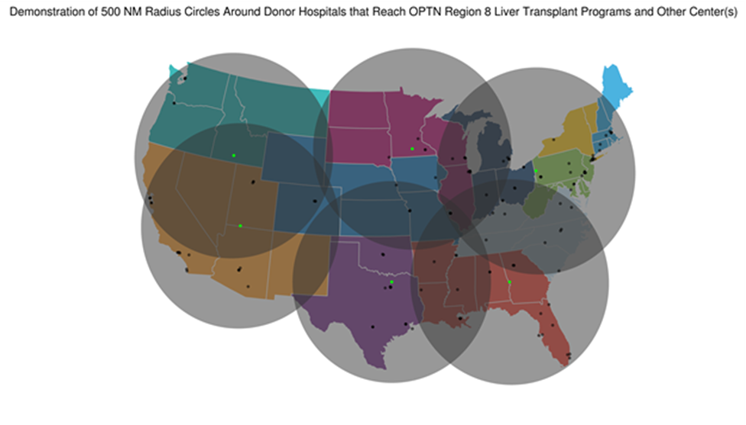
500nm Radius Circles Around Donor Hospitals

Slide 11
Deceased Donor Split Liver Transplants in the U.S., During January 1, 2014 to December 31, 2018, Stratified by Transplant Year
Transplant Year | N | %
2014 | 126 | 16.2
2015 | 122 | 15.7
2016 | 176 | 22.6
2017 | 176 | 22.6
2018 | 178 | 22.9
Total | 778 | 100.0
Notes:
Counting number of transplants (so 1 split liver transplanted into 2 people counts as 2 in this total)

Slide 12
Deceased Donor Split Liver Transplants in the U.S., During January 1, 2014 to December 31, 2018, by Year and OPTN Region
Transplant Recipient OPTN Region | Transplant Year
 | 2014 |  | 2015 |  | 2016 |  | 2017 |  | 2018 |  | Total
 | N | Column % | N | Column % | N | Column % | N | Column % | N | Column % | N | Column %
1 | 6 | 4.8 | 8 | 6.6 | 22 | 12.5 | 16 | 9.1 | 6 | 3.4 | 58 | 7.5
2 | 26 | 20.6 | 12 | 9.8 | 28 | 15.9 | 32 | 18.2 | 22 | 12.4 | 120 | 15.4
3 | 6 | 4.8 | 6 | 4.9 | 5 | 2.8 | 4 | 2.3 | 14 | 7.9 | 35 | 4.5
4 | 4 | 3.2 | 12 | 9.8 | 2 | 1.1 | 12 | 6.8 | 2 | 1.1 | 32 | 4.1
5 | 28 | 22.2 | 32 | 26.2 | 36 | 20.5 | 32 | 18.2 | 44 | 24.7 | 172 | 22.1
6 | 0 | 0.0 | 2 | 1.6 | 2 | 1.1 | 0 | 0.0 | 4 | 2.2 | 8 | 1.0
7 | 10 | 7.9 | 18 | 14.8 | 18 | 10.2 | 14 | 8.0 | 10 | 5.6 | 70 | 9.0
8 | 6 | 4.8 | 0 | 0.0 | 12 | 6.8 | 8 | 4.5 | 6 | 3.4 | 32 | 4.1
9 | 20 | 15.9 | 14 | 11.5 | 18 | 10.2 | 20 | 11.4 | 24 | 13.5 | 96 | 12.3
10 | 12 | 9.5 | 10 | 8.2 | 16 | 9.1 | 24 | 13.6 | 26 | 14.6 | 88 | 11.3
11 | 8 | 6.3 | 8 | 6.6 | 17 | 9.7 | 14 | 8.0 | 20 | 11.2 | 67 | 8.6
Total | 126 | 100.0 | 122 | 100.0 | 176 | 100.0 | 176 | 100.0 | 178 | 100.0 | 778 | 100.0
Notes:
Shows how many splits are done in each region in the last few years.
Counting number of transplants (so 1 split liver transplanted into 2 people counts as 2 in this total)

