Slide 1
Region 2 Meeting
Matthew Cooper, MD
Regional Councillor
Notes:
Welcome to the spring Region 2 meeting. We know you took time out of your schedule to be here and your attendance is appreciated. I would also like to thank CareDx, Promethera, and Sanofi Genzyme for exhibiting at our meeting today.

Slide 2
Meeting Agenda
Update from OPTN/UNOS leadership
Regional discussion session
Review and discuss 5 policy proposals, a concept paper, a guidance document, and a white paper
Updates on committee activities: Liver, Pediatric, and Disease Transmission Advisory Committees
Notes:
Today’s meeting includes
An update from OPTN/UNOS leadership – – Brian Shepard, UNOS Chief Executive Officer
A regional discussion session –this is an opportunity to have a region-wide discussion about a regional or national issue. Today’s topics include a presentation from the UNOS Information Technology staff to discuss projects they are working on to meet the needs of the transplant community. We will also hear a presentation about ending authorization discards.
Discuss and comment on 5 policy proposals, a concept paper, a guidance document, and a white paper – your feedback will be shared with the sponsoring committees
You will also hear updates from the Liver, Pediatric, and Disease Transmission Advisory Committees

Slide 3
Fall 2019 Regional Meeting Date
Fall 2019 public comment: August 2 – October 2, 2019
Proposals will go to the Board for review in December
Coming soon - proposed Fall regional meeting date
Notes:
Regional meeting cycle occurs during the public comment cycle
Public comment proposals we discuss today will be reviewed by the Board in June
Fall public comment cycle will begin August 2 and end October 2 and proposals we discuss at the fall meeting will be reviewed by the Board in December.
We will propose a date for our fall meeting in the coming weeks – please let us know if it works for you

Slide 4
Regional Business
As Councillor, my role is to:
Oversee regional operations
Serve as the region’s representative to the OPTN/UNOS Board of Directors
Share the region’s comments on public comment proposals
To best represent the region, I need to hear from you
Act in the best interest of the OPTN and UNOS
Warm welcome to new attendees at this meeting!
Welcome members of the Board of Directors
Notes:
As regional councillor, I chair the regional meetings and oversee regional operations
I serve as the region’s representative to the Board of Directors
I provide the region’s comments on public comment proposals
We need to hear from you, so speak up at the meeting today, and feel free to email or call me with any issues or concerns.
As a board member, I make decisions in the best interest of the OPTN and UNOS.
I would like to welcome the people who are attending our regional meeting for the first time. I know you will find value in today’s meeting and we are glad you are here.
I would also like to welcome the Board members in attendance. If you would, please stand and state your position on the Board. Board members who might attend (all are registered): Dr. David Reich, Mr. Robert Goodman, Mr. Charlie Alexander, Dr. Jerry McCauley

Slide 5
Region 2 Meeting Attendance
Notes:
Here is our region’s meeting attendance over the last 3 meeting cycles compared to the nation
Region 2 data is in red and national data is in blue.
Goal is to have at least one representative from each OPO, transplant center and histocompatibility lab.
I would ask that everyone in the room share the information you receive here today with at least one person from your organization who did not attend, and encourage them to attend next cycle

Slide 6
OPTN/UNOS Committee Interest

Slide 7
OPTN/UNOS Committee Vacancies (terms beginning July 2019)
Regional nominating committee: selected primary and secondary representatives for each Region 2 vacancy
Committee leadership: reviewing committee rosters; finalizing for OPTN President-Elect review
Purpose: ensure committee staffing needs are met, and project expertise is represented
President-Elect reviews the membership of all committees and approves appointments
Purpose: goal is for committee composition to represent the communities we serve – ensuring a balance of professions, perspectives, race, gender
New committee members will receive notice by early March
Notes:
Thank you to everyone who submitted a nomination to serve as a regional representative on a committee. Regional nominating committees selected candidates for each committee vacancy.
Committee leadership is reviewing the rosters now to make sure each committee has the members it needs to do the work of the committee over the next year.
OPTN President-Elect, Dr. Maryl Johnson, will review the committee rosters to make sure the committee composition represents the communities we serve and includes a balance of specialties, perspectives, race and gender.
Members appointed to committees will receive notice in early March.
Should you need it, here is what we base regional selections on:
-professional experience
-committee’s needs for subject-specific expertise
-diversity in profession and demographics
-past regional engagement
-candidate’s ability to represent both regional and national perspectives
-geographic balance in the region
FYI – in case you need it, the Nominating Committee membership includes the following members: current councillor Dr. Matthew Cooper, associate councillor Dr. Michael Moritz, immediate-past councillor Dr. David Reich, and OPO representative Susan Stuart

Slide 8
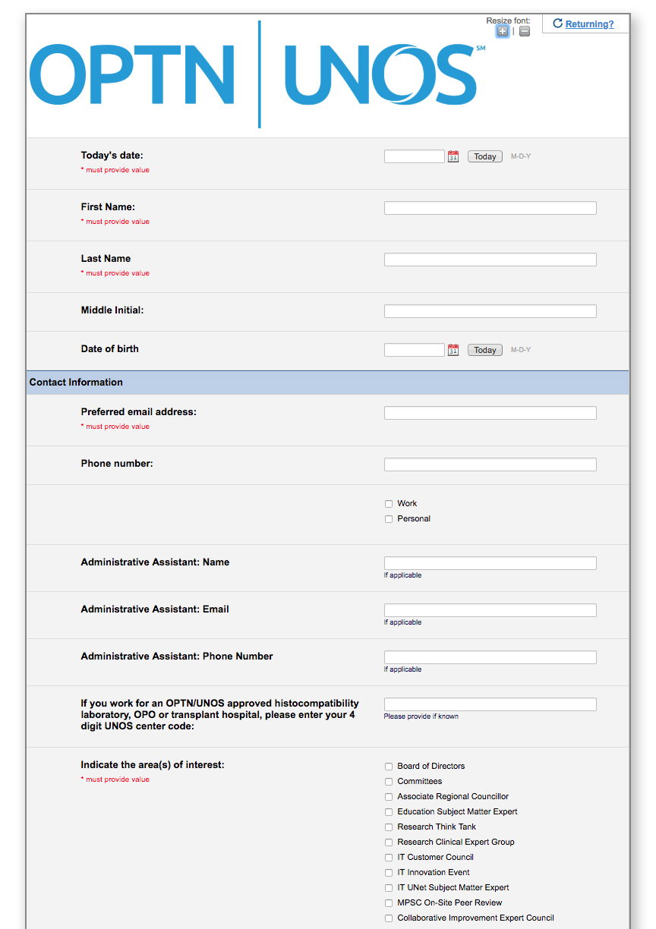
OPTN/UNOS Bio Form
Update your form annually to be considered for governance volunteer positions
http://optn.transplant.hrsa.gov/
Members > Get Involved
Notes:
We have a bio form that you can complete if you are interested in serving in a future volunteer role – this includes committee, Board, and other volunteer positions.
The form is accepted on a rolling basis year-round.
Be sure to update your biography form annually to show your continued interest whether you have served before or want to serve in a volunteer role.
Keeping your form updated will ensure your name is available to UNOS staff in the event a vacancy needs to be filled mid-cycle due to resignations or moves
We also encourage professionals to refer recipients, donors and donor families to this form if you think they’d be well suited for Committee service

Slide 9
Region 2 Leadership
Associate Councillor/MPSC representative
Dr. Adam Frank, Thomas Jefferson University Hospital
Term: Associate Councillor: July 1, 2019 - June 30, 2021
Councillor: 2021-2023
Councillor beginning July 1, 2019 - June 30, 2021
Dr. Michael J. Moritz, Lehigh Valley Hospital
Notes:
Dr. Adam Frank was elected as the region’s next Associate Councillor. Dr. Frank’s term will begin in July, and Dr. Michael Moritz will begin HIS term as Councillor.

Slide 10
What are we here to do today?
Primary purpose: gather feedback on public comment proposals from everyone, which requires your participation! We want you to…
Ask questions
Share your comments and perspectives
Vote (feedback is advisory to me and the Board)
Network with colleagues and catch up
Share information and learn from one another
Notes:
Primary reason is to get feedback on public comment proposals from everyone here. Which means we want you to actively participate today. We want you to ask questions and share your comments and perspectives. The feedback we collect today is advisory for me as the councillor and helps me represent the viewpoints of our region to the Board. It also gives the Board information about the sentiment of the community.
We are also here to network with our colleagues, share information and learn from one another.

Slide 11
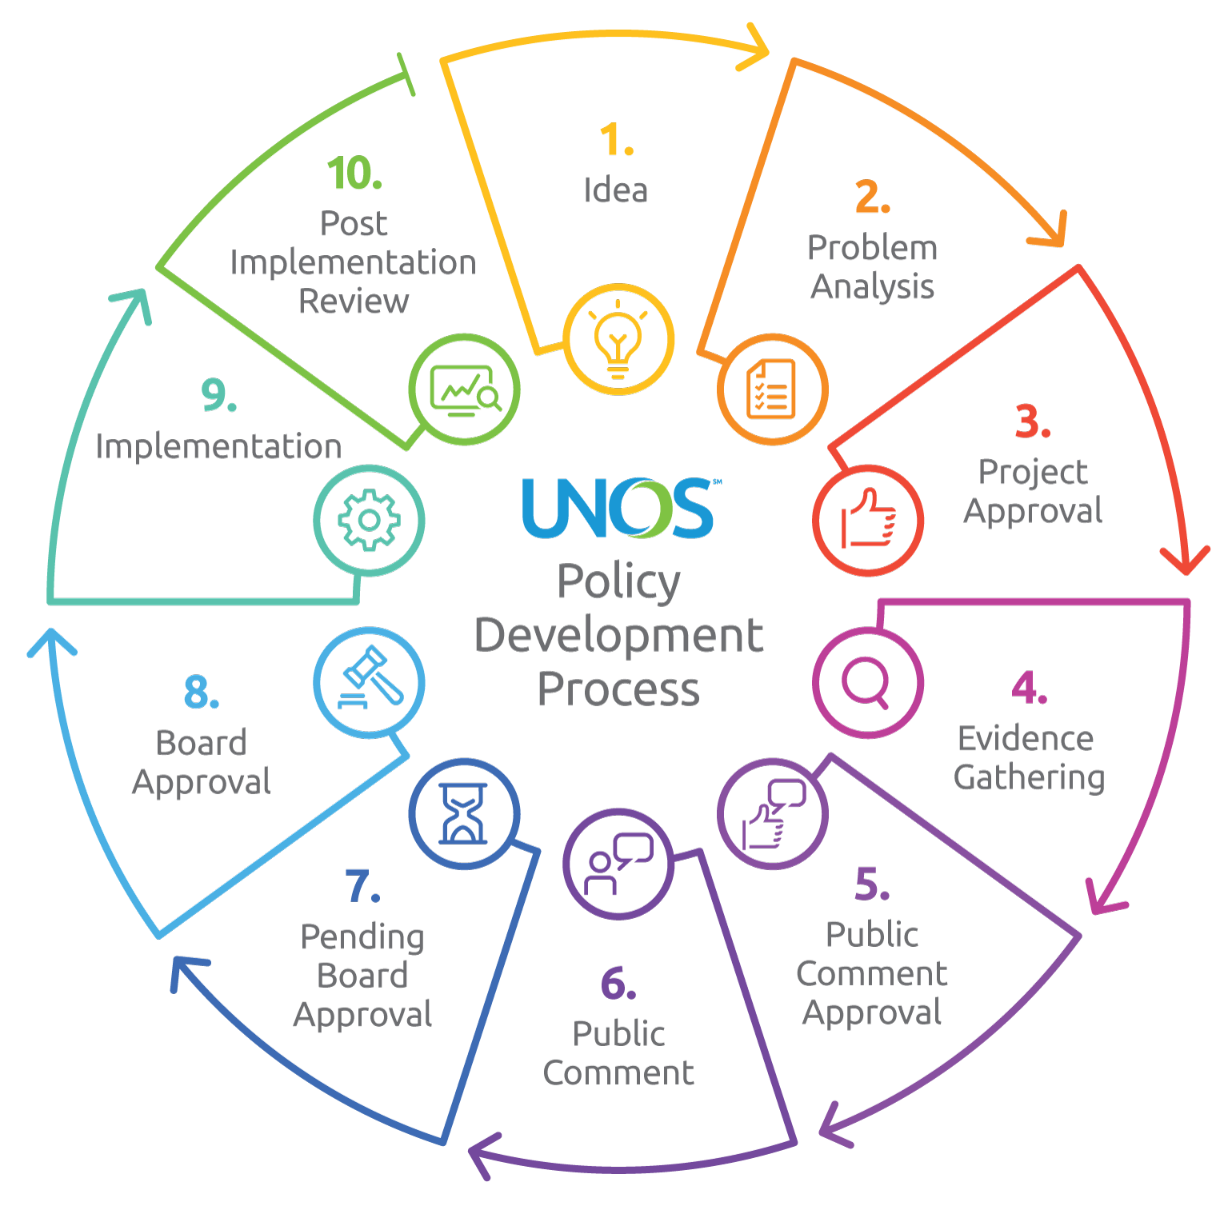
How are policies developed?
Notes:
To get us started, I’d like to focus on our primary purpose – getting feedback on public comment proposals.
This image on the slide is a high-level overview of the policy development process. This is also included in the meeting booklet and I would ask you to take a look at that document as I explain the chart.
We are at Step 6 - public comment.
Items to the right of Step 6 list everything that occurs before a proposal can even be presented at a regional meeting. Everything starts with an idea or a problem to solve.
Items to the left explain what happens after we leave this meeting and public comment ends. Step 7 –committees review all feedback collected, considering post-public comment changes, and making their final recommendations to the Board.
The Board will receive all feedback collected during public comment, review the committee’s final recommendations, and vote on whether to adopt the proposed changes.
The Board looks at feedback from all regions, individuals, and other groups and determines what is best for the OPTN as a whole.

Slide 12
How will we provide feedback?
Thorough discussion on all proposals
Answer specific questions the committee wants us to consider
Talk about merits of the proposals
Suggest improvements
Notes:
Your feedback is key to develop policies and bylaws that are comprehensive and able to be operationalized by the community.
We want to know why you support a proposal and if you oppose a proposal tell us why.
Today, we will talk about the merits of each proposal and suggest ways to make them better.

Slide 13
Regional Sentiment
Voting is another form of expressing your viewpoint about a proposal, it helps us quantify the feedback
We don’t follow a specific order for voting
Vote on the proposal as is;
Vote on the proposal as is and suggest changes;
Identify changes and then vote
Important that you understand how to express your opinion and what we are voting on vs. following a specific order
Comments and votes are our best effort to communicate regional sentiment
Notes:
We don’t follow a specific order for voting, so we don’t follow Robert’s Rules.
We can vote on a proposal as written, vote on a proposal as is and suggest changes, sometimes in the form of an amendment, or we can identify changes and then vote.
The amendment process is one way committees have found helpful to learn what revisions to the proposal would achieve broader consensus.
It is more important that you know what we are voting on versus following a specific order for voting.

Slide 14
Public Comment Opportunities
Contact Regional Representatives
List is located in the meeting booklet and on Transplant Pro: select the community tab, and then “regions”
Submit public comment online
OPTN website: http://optn.transplant.hrsa.gov/governance/public-comment/
Public comment closes March 22
Notes:
If you have feedback on any of the public comment proposals, you can contact our region’s representative to the sponsoring committee.
A list of our region’s representatives is located in the booklet at your seat and also on the Transplant Pro website.
I encourage you to submit an individual public comment online through the OPTN website by March 22.

Slide 15
Electronic Feedback
Voting reps received instructions at the registration desk
Goal: Better understanding of perspectives in the regional vote
Notes:
Voting reps will submit responses using Poll Everywhere. Getting responses electronically will help the committees and Board better understand the perspectives in the regional vote - OPOs vs. transplant centers vs. histo labs.

Slide 16
Enhanced Response Scale
Strongly Support
Support
Abstain/ Neutral
Oppose
Strongly Oppose
Notes:
In the last year, we introduced an enhanced response scale.
This scale helps the committees and board understand how strongly the transplant community feels about a particular proposal. I’ll show an example on the next slide
We do want to know the region’s sentiment about proposals – regions help us understand geographic differences. The information received today helps us quantify the feedback.
We want to collect feedback on an individual basis and slice the feedback by different demographics so that we can better understand the member perspective.
Here is an example of why collecting feedback this way is important: Imagine if all of the OPOs in the country opposed a proposal and all of the hospitals supported it. The regional feedback would look like 11 regions in favor and 0 against. But that only tells part of the story. By collecting feedback on an individual level, we can aggregate it by region and also by demographics such as member type

Slide 17
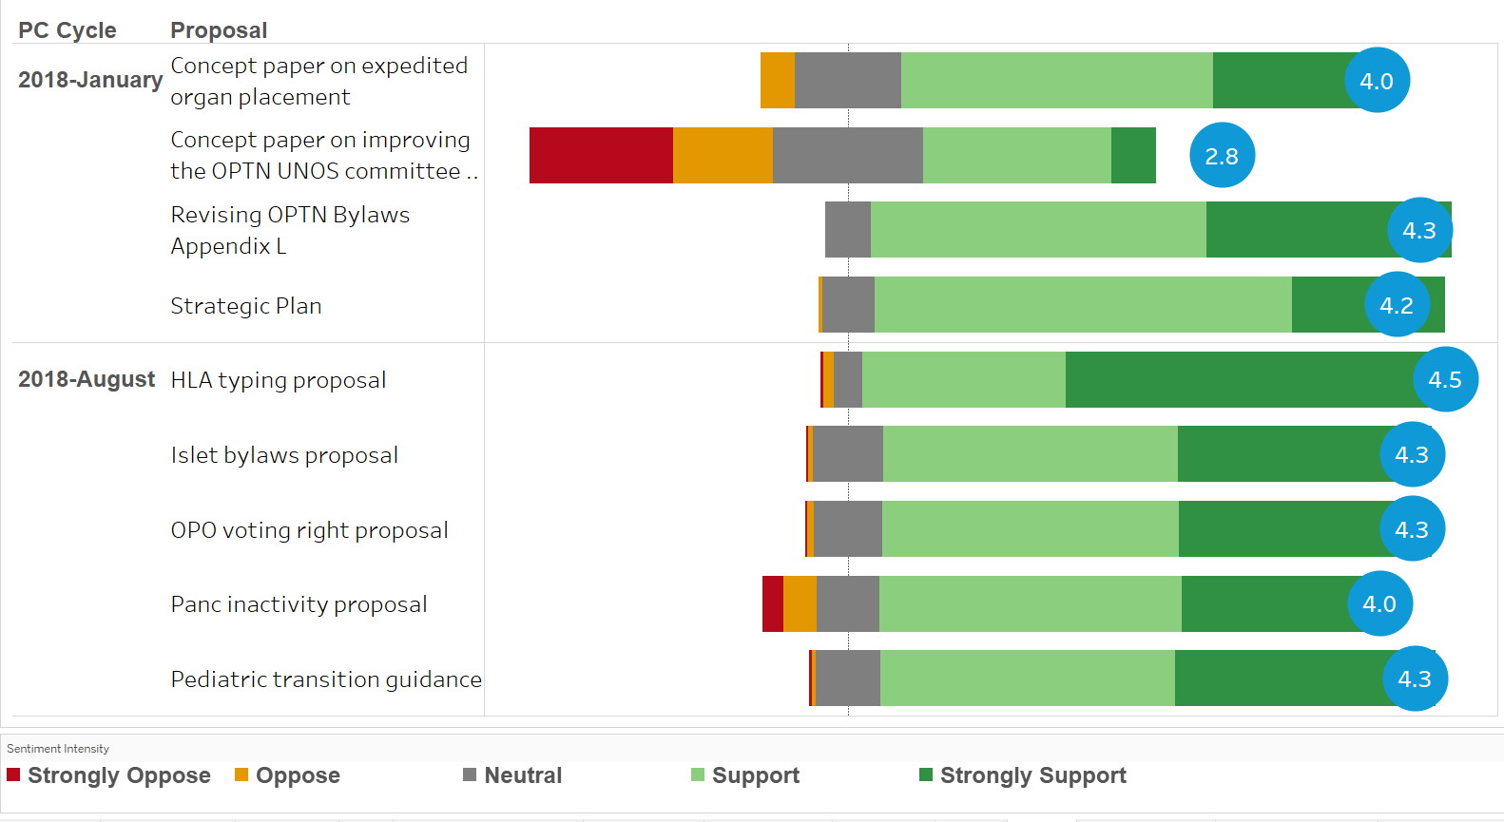
Enhanced Voting Scale
Notes:
This graphic shows the sentiment across recent public comment proposals.
Fortunately, most of our proposals receive a lot of support. So you see a lot of green on these charts.
Within each proposal, you can see some gradations of support of opposition. For example, look at the concept paper on restructuring the committee. There was roughly the same number of people supporting and opposing it. But the people who opposed it were really against it whereas the people that supported it were not strongly supporting it. We can also see a fair number of people gave feedback on the proposal but were neutral overall.
This information is used to help the Board and committees better understand the views of the transplant community.

Slide 18
Voting Reps – Let’s Practice!
Follow instructions provided at registration
Raise your hand if you need assistance
Response system – web-based
Collects regional sentiment on public comment proposals
Only used by voting reps
Test question – please respond
Notes:
We are going to practice using the response software.

Slide 19
Regional Meeting Agenda: Non-Discussion
Includes proposals anticipated to be:
less controversial,
minimal impact on the transplant community, and/or
represent a clerical change to clarify policy or remain current with clinical practice
Region was offered an opportunity to request that a proposal(s) be placed on the discussion agenda
Proposals will be voted on today, but not presented or discussed
Proposals presented and discussed during national webinars
Notes:
Proposals on the non-discussion agenda are anticipated to be less controversial, have minimal impact on the donation and transplantation community, and/or represent a clerical change to clarify the intent of policy or to remain current with clinical practice.
You were provided an opportunity to request a proposal on the non-discussion agenda be moved to the discussion agenda. We moved the Operations and Safety Committee’s guidance document from non-discussion to discussion.
The non-discussion proposals will not be presented or discussed today. Webinars are available to learn about the proposals.

Slide 20
Non-Discussion Proposals: Vote
You have the option to abstain from voting if you haven’t reviewed the proposals
Modify HOPE Act Variance to Include Other Organs (Ad Hoc Disease Transmission Advisory Committee)
Clarifications on Reporting Maintenance Dialysis (Living Donor Committee)
Notes:
Here is a list of proposals on the non-discussion agenda that we will vote on today. **Read the title of each proposal**
The plan is to take one vote on all three items unless anyone is opposed to a specific proposal. If you haven’t reviewed a proposal on this list and will abstain from voting or will vote to oppose a proposal, please raise your hand and we will vote on each proposal separately. Otherwise we will vote on the 3 of them in one vote.
Note to councillors:
If no hands are raised, take one vote on both items: strongly support, support, oppose, strongly oppose, abstain/neutral.
If hands are raised: vote on each proposal separately: strongly support, support, oppose, strongly oppose, abstain/neutral.

Slide 21
Regional Meeting Materials – online!
Today’s presentations are posted on Transplant Pro
Make sure to review the non-discussion proposals and committee updates not presented today
Notes:
Committee presentations and meeting materials are on the Transplant Pro website
Some committees did not present updates at today’s meeting and presentations on their activities are also posted to Transplant Pro

Slide 22
Framing the Day
We want feedback from as many attendees as possible
To manage the discussion on each proposal, please limit your comments to new comments, points that haven’t been raised
To be sure your comments and questions are heard, please use microphones

Slide 23
Questions?
Notes:
Thank you for your attention and I am happy to answer questions.

