Slide 1
Ad Hoc Geography Committee Update
Fall 2018

Slide 2
June 2018 Board Actions
Board approved 5 principles of geographic distribution
Vote:
32 Approve
5 Oppose
Approved distributing 3 geographic frameworks for public comment that align with the principles

Slide 3
Principle of Distribution | Final Rule Requirement
Deceased donor organs are a national resource to be distributed as broadly as feasible | §121.8(a) “... allocation policies: (8) Shall not be based on the candidate’s place of residence of listing ...” §121.8(b) “Allocation policies shall be designed to achieve equitable allocation of organs among patients... through the following performance goals, (3) distributing organs over as broad a geographic area as feasible ...”
Reduce inherent differences in the ratio of donor supply and demand across the country | §121.8(a) “... allocation policies: (5) Shall be designed to ... promote patient access to transplantation, and to promote the efficient management of organ placement.”
Reduce travel time expected to have a clinically significant effect on ischemic time and organ quality | §121.8(a) “... allocation policies: (1) Shall be based on sound medical judgment; (5) Shall be designed to avoid wasting organs...”
Increase organ utilization and prevent organ wastage | §121.8(a) “... allocation policies: (5) Shall be designed to avoid wasting organs ...”
Increase efficiencies of donation and transplant system resources | §121.8(a) “... allocation policies: (5) Shall be designed to … promote the efficient management of organ placement...”
Notes:
This table shows how each principle relates to a part of the Final Rule
(You can read each principle and its corresponding Final Rule part)

Slide 4
Frameworks for Geographic Distribution
Ad Hoc Geography Committee

Slide 5
Distribution Frameworks
Committee identified three distribution frameworks consistent with the Principles and the OPTN Final Rule
Committee recommends further discussion and community feedback
Goal: identify a single, preferred distribution framework to be used across all organs
Distribution Frameworks
1. Fixed Distance from the Donor Hospital
2. Mathematical Optimization
3. Continuous Distribution
Notes:
The Committee also identified three frameworks for geographic distribution that it finds to be consistent with the principles and with the Final Rule. The Committee recommends further discussion by the Board and by the community of the merits of the three frameworks, but agrees that the system would be best served by adopting a single common framework to be applied to all organ allocation policies. Even within a common framework, each organ would have medically determined factors that apply specifically to that organ. The three frameworks identified by the Committee are:
Organ Distribution Based on Fixed Distance from the Donor Hospital
Organ Distribution Based on Mathematical Optimization
Organ Distribution without Geographic Boundaries

Slide 6
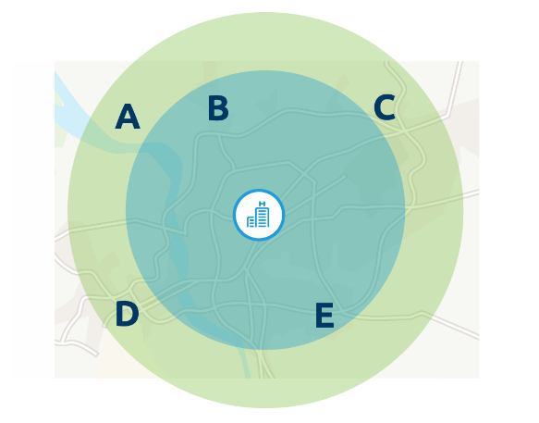
Fixed Distance from Donor Hospital
Advantages:
Easy to explain
Extends distribution area, particularly for medically urgent patients
Disadvantages:
Fixed boundaries
Differences in population density may affect patients with similar matching characteristics
Notes:
Illustrations, Animation and Kevin O’Connor video can be found at: https://transplantpro.org/policy/organ-distribution/
This framework creates fixed geographic areas based on the distance between the donor hospital and the transplant candidate’s hospital. While local matches may receive priority, this approach may also allow wider distribution for other characteristics such as medical urgency.
In this example, the donor hospital is located between and relatively close to transplant hospitals B and E. Candidates at hospitals B and E are within the first proximity circle. Candidates at transplant hospitals A, C and D are in a wider circle. If there are no major differences in urgency between candidates at any of the hospitals, the local candidates at hospitals B or E would appear on a match run before those in the wider circle. But if a candidate at hospital C is considerably sicker than any at hospital B or E, the system could prioritize that candidate ahead of more local candidates.
ADVANTAGES
Easy to explain
Allows you to consider organ-specific constraints such as travel time.
Extends distribution to a larger area – this means medically urgent patients across a broader area could receive an organ.
DISADVANTAGES
However the proximity is determined, it uses fixed boundaries. As a result, two candidates who have similar matching characteristics and level of medical urgency may be treated very differently because they fall in different zones, even though they may be just a few miles apart.
Also, there are differences in population density from one area of the country to another. This may mean that circles of the same size across the country could result in having a higher or lower number of potential candidates within the zones.

Slide 7
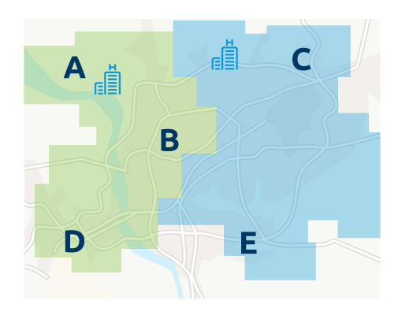
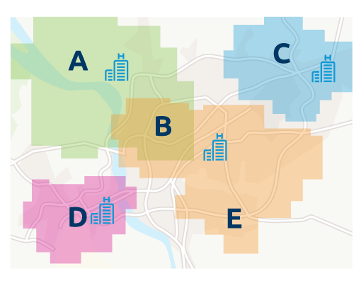
Mathematically Optimized Boundaries
Advantages
Provides consistent results
Can be monitored and scaled
Disadvantages
Boundaries may be complex and not uniform
Fixed boundaries
Limited number of large districts
Large number of localized neighborhoods
Notes:
Mathematical optimization can be used to establish distribution boundaries. The boundaries are based on a statistical formula designed to achieve the best results for one or more specific goals, such as having a consistent ratio of donors to potential recipients within each distribution area. Distribution areas could range from a limited number of large districts to a relatively large number of localized neighborhoods. Their shape could also be customized to account for unique issues of demographics, geography or clinical factors. Neighborhood boundaries could overlap if the factors used to calculate them share common characteristics, thus an individual transplant hospital may be in more than one neighborhood.
Limited number of large districts
In this example transplant hospitals A, B and D are in one distribution district, with hospitals C and E in a separate district.
Larger number of localized neighborhoods
Using a neighborhood approach, hospitals A and B and B and E are in common neighborhoods, while hospitals in C and D are in separate neighborhoods. Candidates at hospital B may thus appear as local matches in either neighborhood the hospital shares with A or E.
ADVANTAGES
Provides consistent results
Can be monitored and scaled according to objective criteria.
DISADVANTAGES
In order to account for differences in population or other characteristics, the boundaries may be complex and may not be as uniform in some areas of the country as they are in others.
This system establishes a fixed boundary - thus, it may treat two patients with similar medical needs and characteristics differently when they are local to each other but are listed at different hospitals that cross a boundary.

Slide 8
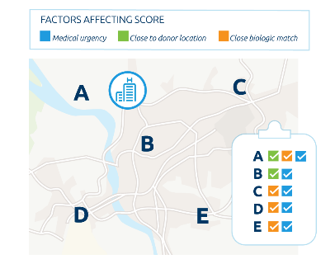
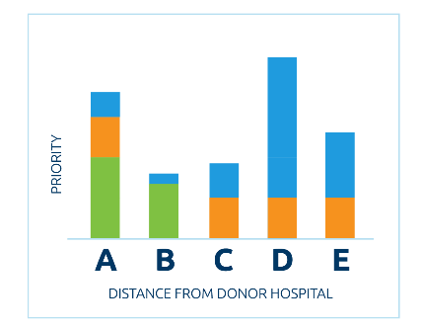
Continuous Distribution
Advantages
Two patients who are similar in suitability would be treated much the same way
Priority would consider specific clinical characteristics about the candidate
More likely that organ offers would be matched efficiently with candidates in highest medical need
Disadvantages
Less easy to understand and explain
May not produce predictable matches
Notes:
Organs can be distributed to candidates using a statistical formula that combines important clinical factors, such as medical urgency and likelihood of graft survival, along with proximity to the donor location. Using this approach, all candidates would receive a relative distribution score, but there would be no absolute geographic boundary. Candidates who best meet the combination of factors receive the highest priority.
No fixed boundaries
In this example, there are no fixed boundaries between transplant hospitals. The donor hospital is closest to Hospitals A and B, so candidates at those two hospitals receive some points for proximity. Hospitals A, C, D and E all have candidates who are a close biologic match. Hospitals D and E both have candidates with elevated medical urgency, with Hospital D having the most urgent candidate.
Combination of factors
When these various factors are combined, a candidate at Hospital D would appear first on the match. This candidate receives no proximity points but ranks strongly based on medical urgency and biologic compatibility. The candidate appearing next on the match is at Hospital A, with a combination of priority for proximity and biological compatibility. Candidates at the other three hospitals appear lower on the match according to how strongly they match on the combined factors.
ADVANTAGES
Without a specific boundary, two patients who are similar to each other in suitability and proximity would be treated much the same way.
The model used to calculate priority would consider specific clinical characteristics about the organ and the candidate - this would make it more likely that organ offers would be matched more efficiently with candidates, and that candidates in highest medical need may receive priority regardless of proximity to the donor hospital.
DISADVANTAGES
The formula may not be as easy to understand and explain.
May not produce concentrated matches in a way as predictable to clinicians as other frameworks may be.

Slide 9
Next Steps
Geography Committee
Fall 2018 PC for 3 Frameworks, Board consideration Dec 2018
Liver Committee
Fall 2017 special PC for feedback on liver distribution models
Other committees begin work to replace DSA & Region
3 projects: thoracic; kidney-pancreas; and VCA
January 2019 Public Comment; June 2019 Board
Geography Committee role and oversight

Slide 10
Timeline by Committee
Geography Projects
Project | Jul-18 | Aug-18 | Sep-18 | Oct-18 | Nov-18 | Dec-18 | Jan-19 | Feb-19 | Mar-19 | Apr-19 | May-19 | Jun-19
Distribution Frameworks |  | PC |  |  |  | BOD
Liver & Intestine Distribution | Modeling |  |  | PC |  | BOD
Kidney-Pancreas Distribution |  |  |  | Modeling |  |  | PC |  |  |  |  | BOD
Thoracic Distribution |  |  |  | Modeling |  |  | PC |  |  |  |  | BOD
VCA Distribution |  |  |  |  |  |  | PC |  |  |  |  | BOD
Develop
SRTR Modeling
Public Comment
Board
Notes:
Now – Sept 4 Weekly/Bi-Weekly Meetings with your Committees
Sept 4 Modeling requests due to SRTR
Nov 5-30 [Or whenever modeling returned] Policy Development Phase
Dec 3 - 21 Public Comment Proposals and associated policy drafted and finalized
Jan 21 – Mar 22 Public Comment Period
Mar 25 – Apr 19 Committees & Staff finalize Board proposals
June 10 – 11 Board of Directors Meeting

Slide 11
Questions?

Slide 12
3 Frameworks with Narration and Animation
Illustrations, Animation and Kevin O’Connor video can be found at: https://transplantpro.org/policy/organ-distribution/

